Slide 1
Stock Price Prediction

Slide 2
Overview
Introduction
Data Overview
EDA
ARIMA
To Do
Model Performance

Slide 3
Data Overview
Stock Price Dataset-
Minute data
Day data

Slide 4
Minute Data Overview
Dataset Size : 1493450
No of features : 25
Target Variable : close
No of Symbols : 602
Null value columns - None
SPY Symbol contains maximum no. of data points. i.e. 5534
Duration : 2020-06-03 04:00:01 - 2020-06-10 20:00:01

Slide 5
Day data overview
Dataset Size : 209569
No of features : 14
Target Variable : Close
No of Symbols : 3828
Null value columns - volume_change, volume_score, bullish, bearish
AIM Symbol contains maximum no. of data points. i.e. 55
Duration : 25/3/2020 - 12/6/2020

Slide 6
Features
Replaced outliers with last seen value.
Generic class -
Initialize with dataset.
Predict based on symbol input.

Slide 7
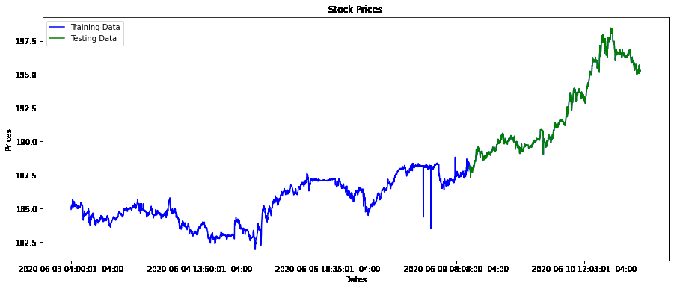
MSFT share price

Slide 8
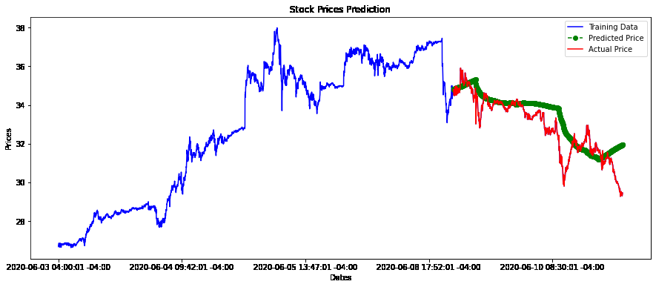
Model : ARIMAX (Symbol : DAL)

Slide 9
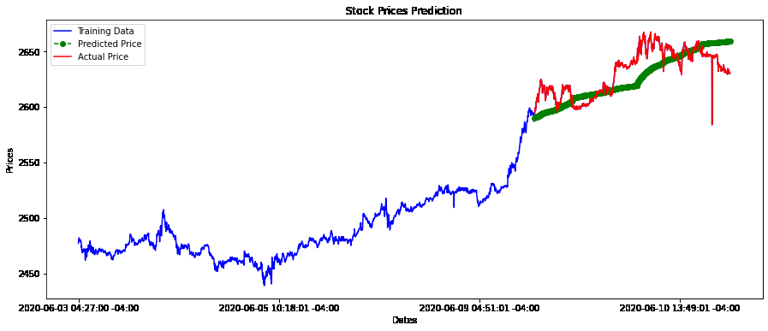
Model : ARIMAX (Symbol : AMZN)

Slide 10
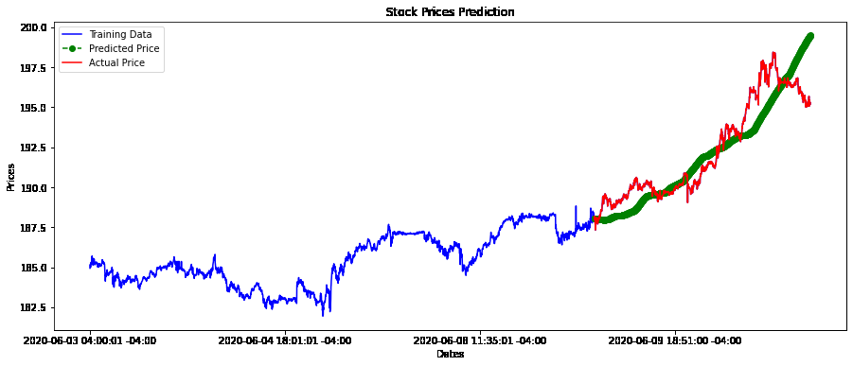
Model : ARIMAX (Symbol : MSFT)

Slide 11
Model Performance
Model | Symbol | RMSE | MAPE
ARIMAX | DAL | 0.903 | 2.0
ARIMAX | AMZN | 16.030 | 0.502
ARIMAX | MSFT | 1.406 | 0.552

Slide 12
To Do
Use deep learning models e.g. lstm, gru, bidirectional lstm.
Use day data for model building.

Slide 13
Thank You!
Jayanth Rasamsetti
340S Lemon Ave, #9172, Walnut, CA, 91789, United States
+918790527858
jay@sgmoid.com

